Slide 1
LM Software in the Cloud Pipeline Class Project FuelFinder™ - “Making Alternative Fuels a Reality”

Slide 2




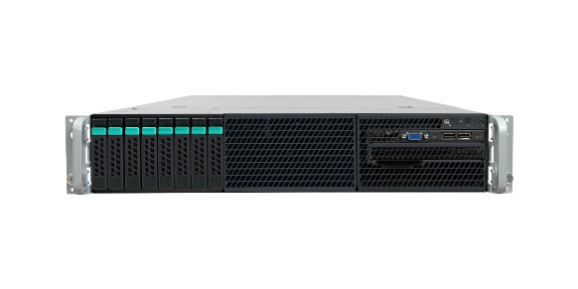

Pipeline Capstone Inspiration – (Gas Pump Price Mobile App – Overall Conceptual Data Flow (OV-1)
Gas Price
Data Base
Sell Access
to Gas Price
Historical
Data for
Industry
Analysts
Nationwide Gas Stations
Monthly Gas
Price Archive
Gas price Historical
Archive Data Base
(up to 5 years)
Consumers Report
Prices during fill-up
Data Capture Server
Data Reporting Server
…
Consumers Check Prices
for GPS-enabled Coordinates
or by Customer–specified location
(lowest price and closest local gas prices
and region-specific advertising
delivered by your mobile app)
Regional Advertising
Data Base
Advertising Sales Team
Link to Goggle Maps for Directions to station

Slide 3


Pipeline Capstone – FuelFinder™ Alternative Fuel Finder Web App – Our Simplified Project (OV-1)
Alt Fuel Station
Data Base
Helpful Google Maps Web Services
GeoCoding API
Google Maps Distance Matrix API
Google Maps Directions API
Nationwide Alternative Fuel Stations
Data Capture Server (you select the hosted AWS database service from LM-Approved Options)
Simulated Consumer Database Entries
On S3 bucket)
Data Reporting Server
(you select the web hosting services for your application from LM-Approved Options)
…
Link to Goggle Maps for Directions to station from customer entered location
Your FuelFinder™ Web App
Allows Consumers to Find Alternative Fuel Stations by Customer–specified location
(sorted by fuel type or distance at user’s choosing)
Note: We are requesting use of native AWS cloud technologies; avoid use of legacy architectures (e.g. classic DB connectivity)

Slide 4
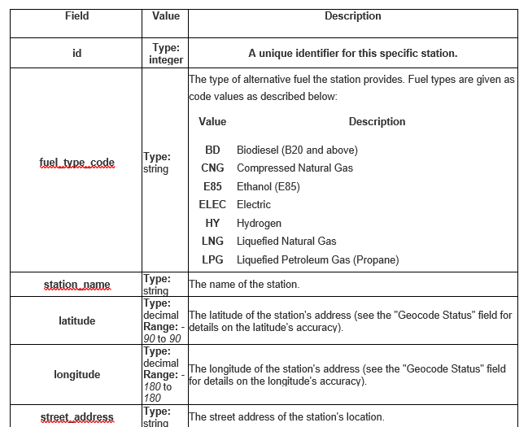
Alt Fuel Station Data Base Definition (provided data in multiple formats for each team hosted on an S3 Bucket)
36 Fields

Slide 5
Alt Fuel Station Raw Data Pick-Up Locations
The raw data and data dictionary for the Software in the Cloud pipeline capstone project is available in an S3 bucket. The bucket is in public east-1, and named “leidalk-pipeline-capstone”. The data originally came from the National Renewable Energy Laboratory (NREL) public web site. There are 28,858 records in the dataset.
Alternative Fuel Raw Data:
CSV format - https://s3.amazonaws.com/leidalk-pipeline-capstone/alt_fuel_stations.csv
JSON format - https://s3.amazonaws.com/leidalk-pipeline-capstone/alt_fuel_stations.json
XML format - https://s3.amazonaws.com/leidalk-pipeline-capstone/alt_fuel_stations.xml
Alternative Fuel Data Dictionary:
MS Word format - https://s3.amazonaws.com/leidalk-pipeline-capstone/Alternative+Fuel+Data+Dictionary.docx
Pre-loaded options based on previous pipeline feedback (could be an alternate starting point for teams):
MS SQL RDS - arn:aws:rds:us-east-1:931775396793:db:leidalkpipelinecapstone
Database : nrel Tablename: alt-fuel-stations (Could use MS SQL Management Studio on Windows EC2 to connect)*
All Fields imported as varchar (string) types (except for id field), no additional indexes on table
Read-only user: pipeline pwd: capstone
DynamoDB- arn:aws:dynamodb:us-east-1:931775396793:table/leidalk-alt-fuel-stations
No local or global secondary indexes created on table (limit of 5 each could be coordinated amongst teams)
If copying to/from DynamoDB table, recommend increasing read or write capacity on table to 100 during operation, then setting back to 5/5. This will prevent alarms and timeouts due to AWS i/o throttling, and minimize cost.
* Hint: Security Group on EC2 will likely need updating

Slide 6
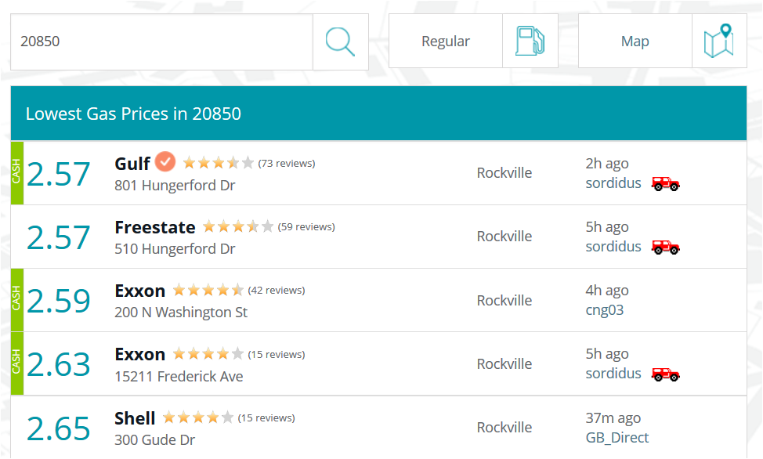


Sample FuelFinder™ Desktop Web Interface (Example…yours may vary)
Address/Zip Code
Fuel Type
Links to Google Maps for Location
Sort Option by Fuel Type
Propane
Sort Option by Distance to Station
Station Name/Address
City
Last Update
Directions
LPG/
Propane
Link to Driving Directions Using Google Maps
LPG/
Propane
LPG/
Propane
LPG/
Propane
LPG/
Propane

Slide 7
Pipeline Project Team Responsibilities
Design the stripped down version of the FuelFinder™ desktop client web application.
Select from available AWS hosting services appropriate for your design.
Migrate alternative fuel station sample data found on S3 bucket (or RDS and DynamoDB) to a suitable AWS Database service of your choosing (your team designs the database schema and table structure or leverages/adjusts sample RDS or DynamoDB repositories).
Implement (develop and test) the application on the selected AWS services leveraging the desired Google Map APIs that are required for distance from starting address/zip code to target fuel station and driving directions to station.
Present your design during the Capstone presentations on Oct 26th with rationale for your design and AWS hosting service choices. (The 4 teams will each have 20 minutes to outbrief their Capstone presentations including a demo on AWS. Highlight what you learned during the Capstone. You will also have 5 min for Q&A at the end of outbrief ).
Some useful Google Map API links
https://developers.google.com/maps/
https://developers.google.com/maps/documentation/directions/
https://developers.google.com/maps/documentation/geocoding/start
https://developers.google.com/maps/documentation/distance-matrix/

Slide 8
The Pipeline Project Teams
Team | Applicant Name | Email | Phone | Location
1 | Champagne, Timothy | timothy.a.champagne@lmco.com | +1 484 636 5548 | Broken Arrow, Oklahoma
1 | Eversole, Scott | scott.eversole@lmco.com | +1 817 763 1731 | Fort Worth, Texas
1 | Moore, Eugene | eugene.l.moore@lmco.com | +1 719 308 7623 | Colorado Springs, Colorado
1 | Raymond, Kiersten | kiersten.j.raymond@lmco.com | +1 832 620 2459 | Fort Worth, Texas
1 | Santos Crespo, Paulino III | paulino.santos@lmco.com | +1 939 630 2671 | Puerto Rico
1 | Stewart, Elizabeth | elizabeth.1.stewart@lmco.com | +1 817 935 3067 | Fort Worth, Texas
1 | Vo, Howard | howard.vo@lmco.com | +1 817 378 2839 | Fort Worth, Texas
2 | Devraj, Vijayalakshmi | viji.devraj@lmco.com | +1 256 763 5482 | Huntsville, Alabama
2 | Keyes, Kelly | kelly.keyes@lmco.com | +1 720 412 3196 | Littleton, Colorado
2 | Mendoza, Jessue | jessue.e.mendoza@lmco.com | +1 972 603 7926 | Grand Prairie, Texas
2 | Patapau, Andrei | andrei.o.patapau@lmco.com | +1 817 762 3682 | Fort Worth, Texas
2 | Rodriguez, Kimberly | kimberly.m.rodriguez@lmco.com | +1 214 600 9453 | New Port Richey, Florida
2 | Vu, Mai | mai.n.vu@lmco.com | +1 817 378 2788 | Fort Worth, Texas
2 | Znamenacek, Dale | dale.anne.znamenacek@lmco.com | +1 970 858 9865 | Fruita, Colorado
3 | Alderson, Andrew | andrew.d.alderson@lmco.com | +1 817 378 2755 | Fort Worth, Texas
3 | Buckwalter, Joseph | joseph.e.buckwalter@lmco.com | +1 240 533 9353 | Huntsville, Utah
3 | Dziekowicz, Ellen | ellen.m.dziekowicz@lmco.com | +1 607 223 7206 | New Hartford, New York
3 | Foster, Raven | raven.a.foster@lmco.com | +1 770 494 0787 | Marietta, Georgia
3 | Gronau, Andriy | andriy.gronau@lmco.com | +1 607 223 7210 | Syracuse, New York
3 | Gruver, Brian | brian.d.gruver@lmco.com | +1 610 927 0890 | King of Prussia, Pennsylvania
3 | Kelly, Brian | brian.j2.kelly@lmco.com | +1 610 354 3485 | King of Prussia, Pennsylvania
4 | Banville, Brian | brian.s.banville@lmco.com | +1 863 607 6853 | Orlando, Florida
4 | Brown, Torrance | torrance.s.brown@lmco.com | +1 407 963 4224 | Orlando, Florida
4 | Cardone, Julie | julie.cardone@lmco.com | +1 407 235 9572 | Orlando, Florida
4 | Jenne, Melissa | melissa.k.jenne@lmco.com | +1 315 735 3976 | Utica, New York
4 | Michaud, Ben | ben.a.michaud@lmco.com | +1 203 551 8019 | Stratford, Connecticut
4 | Rosato, Christopher | chris.rosato@lmco.com | +1 607 223 0178 | Owego, New York
4 | Whalen, John | john.j.whalen@lmco.com | +1 203 386 7567 | Stratford, Connecticut

Slide 9
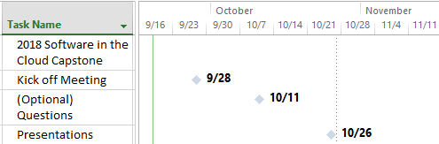
Pipeline Project Schedule

Slide 10


